Slide 1
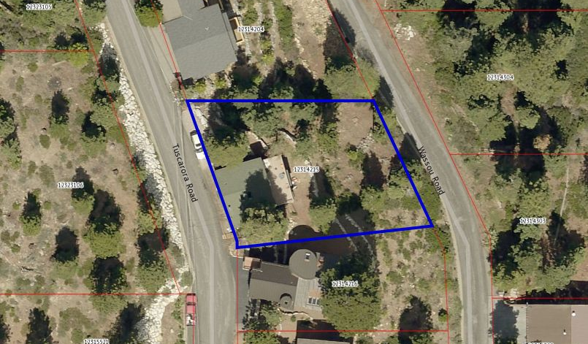
WPVAR17-0001 (Meyer-McSherry)
Washoe County Board of Adjustment
April 6, 2017

Slide 2
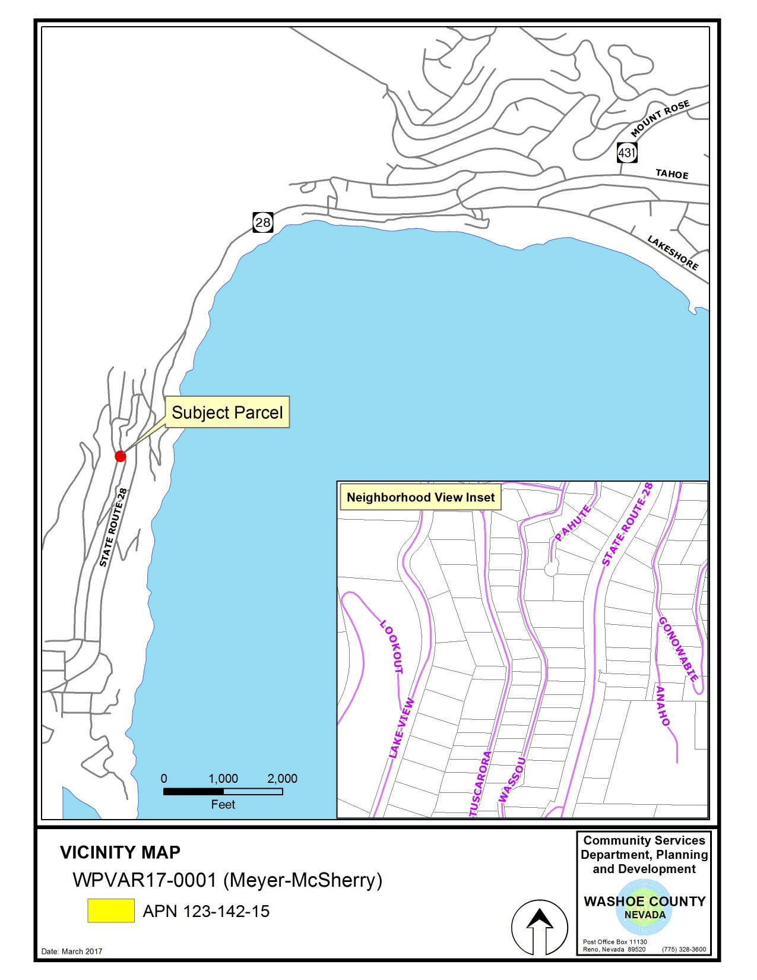
380 Tuscarora Rd
Crystal Bay

Slide 3
Background
Subject property is zoned High Density Suburban – 20 foot front and 5 foot side yard setbacks
Previous variance request continued (7’ F/3.5’ S) – project has been redesigned, tree removed
Now requesting a reduction to only the front yard setback (from 20 feet to 10 feet 8 inches)
Proposed 2 car garage and an associated hallway connection to the existing house

Slide 4
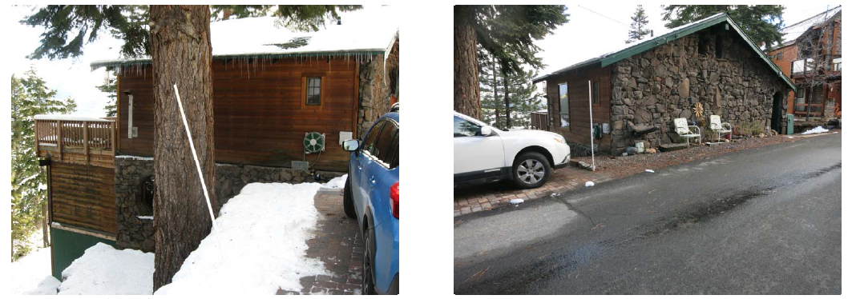
Background
Existing parking pad is partially in the ROW

Slide 5
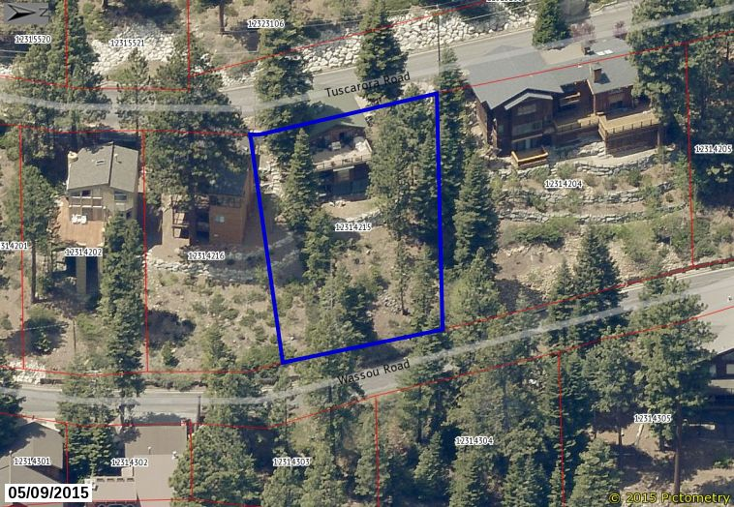
Background

Slide 6
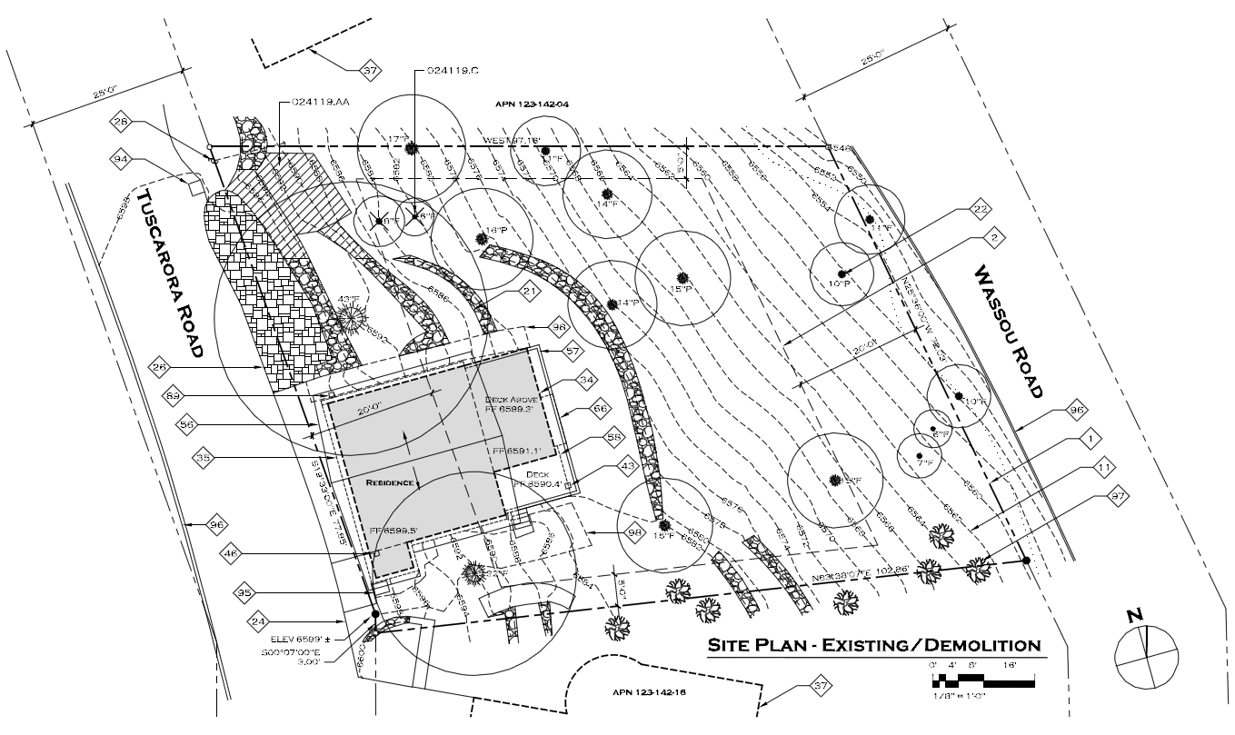
Existing Site Plan

Slide 7
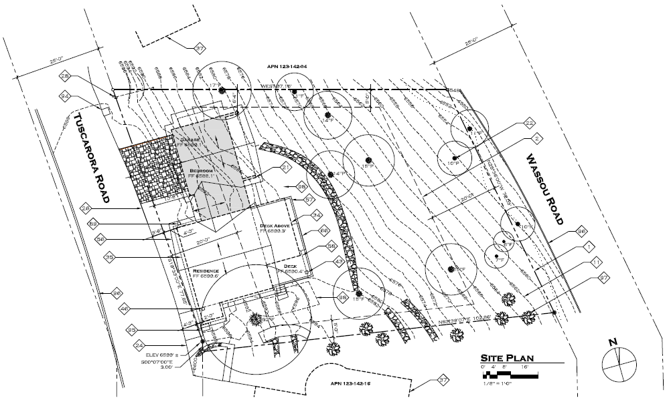
Proposed Site Plan

Slide 8
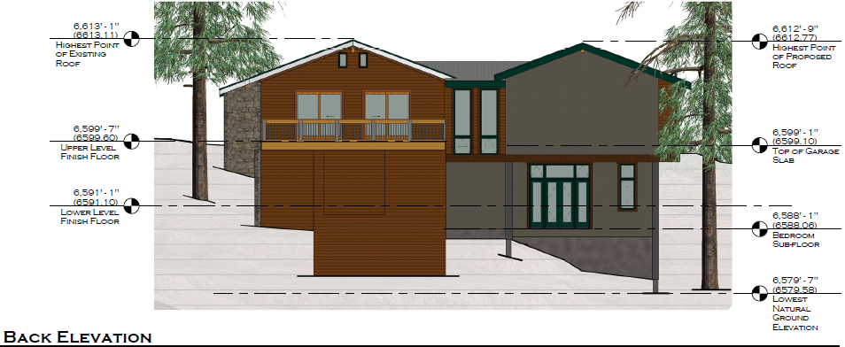
Elevations

Slide 9
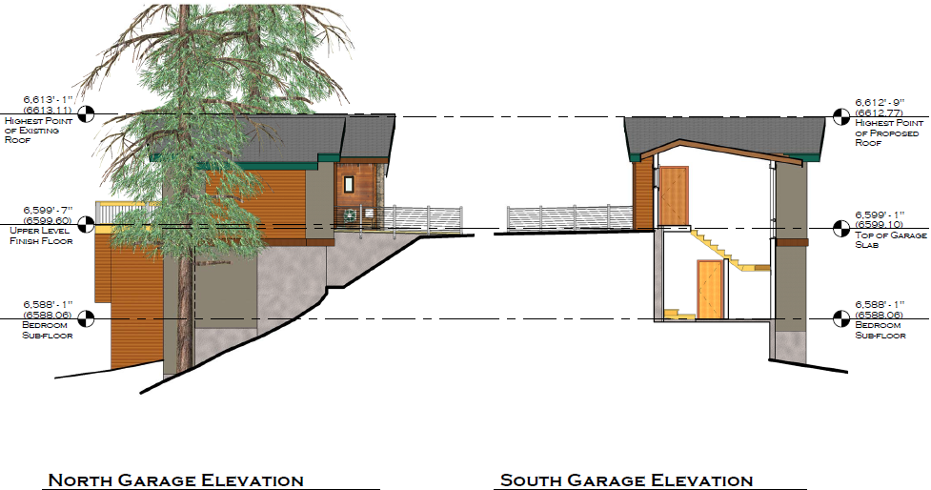
Elevations

Slide 10
Analysis
The parcel is not exceptionally narrow, but is extremely sloped (over 40% grade)
Existing 552 s.f. residence built in 1966 is already within the front yard setback (by approx. 18 feet)
Currently no garage
On street parking is very limited
Most of the houses on the down sloping side of Tuscarora are built into the front yard setback

Slide 11
Analysis
Special circumstances exist (topography, ROW)
No detriment to the public good:
Upslope property views (parcel x street vacant)
Provide off street parking
No grant of special privileges – similar adjacent properties and setback relief, exist. house
Proposed accessory use is authorized

Slide 12
Reviewing Agencies
Washoe County Community Services Department
Planning and Development Division
Engineering and Capital Projects Division
Land Development
Roads
North Lake Tahoe Fire Protection District
Incline Village General Improvement District
Regional Transportation Commission

Slide 13
Reviewing Agencies
2 out of the 6 reviewing agencies requested conditions of approval:
Planning and Development
Engineering and Capitol Projects Division, Land Development
See Exhibit A of the staff report for the recommended conditions of approval (standard conditions)

Slide 14
Citizen Advisory Board / Public Comment
The Incline Village/Crystal Bay Citizen Advisory Board reviewed the project at its March 27th mtg.
The CAB had questions about the slope of the property, the existing house (variance?), size of the garage, and if the side yard setback was met
The CAB recommended approval by a unanimous vote citing compatibility with adjacent properties
Staff has not received any other public comment (and no contact from the side yard neighbor)

Slide 15
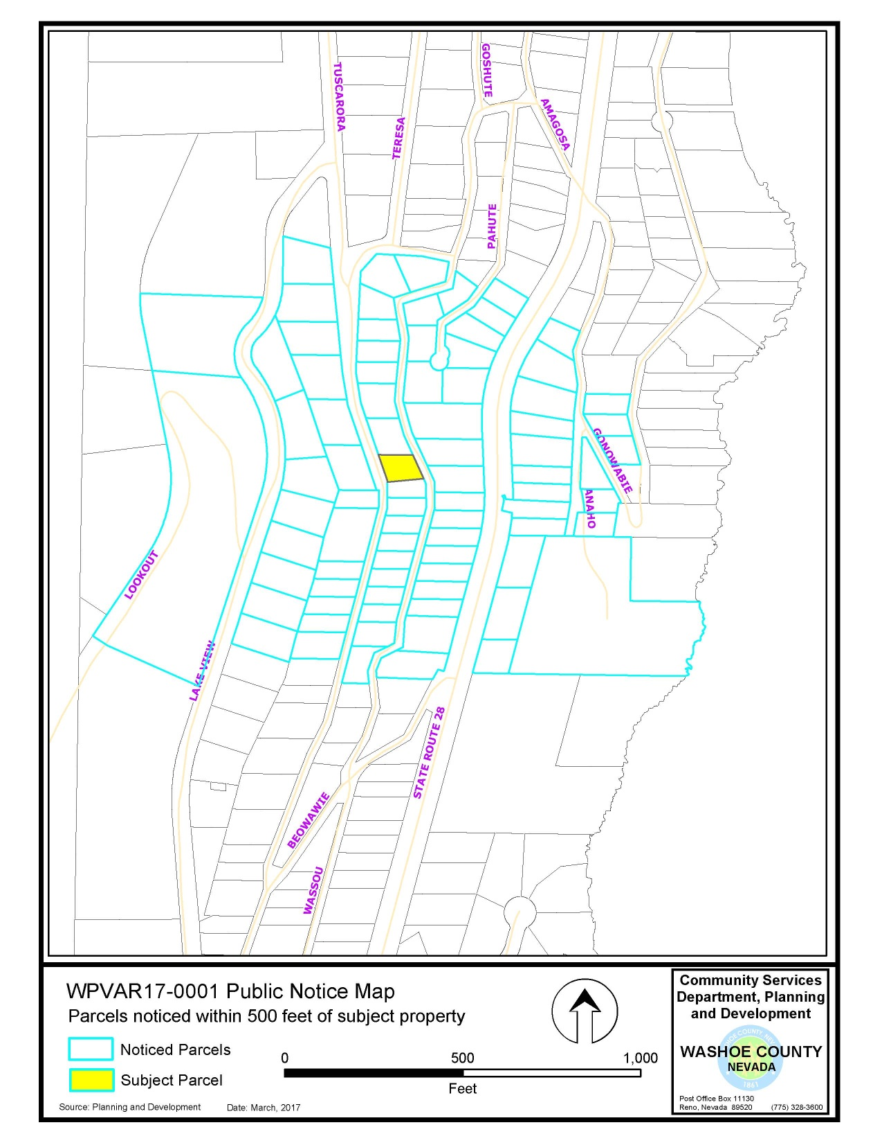
A total of 47 properties were noticed

Slide 16
Required Findings
WCC Section 110.804.25, Variance Findings:
Special Circumstances (Exceptional narrowness, exceptional topography, exceptional situation)
No detriment
No special privileges
Use authorized
Effect on Military Installation

Slide 17
Required Findings
Staff analysis is provided in the staff report starting on page 8
Staff is able to make all of the required findings

Slide 18
Staff Recommendation
After a thorough analysis and review, Variance Case Number WPVAR17-0001 for Meyer-McSherry is being recommended for approval with conditions.

Slide 19
Possible Motion
I move that, after considering the information contained within the staff report and the information received during the public hearing, the Washoe County Board of Adjustment approve, with the conditions included at Exhibit A to the staff report for this item, Variance Case Number WPVAR17-0001 for Meyer-McSherry, being able to make the findings required by Washoe County Code Section 110.804.25 for approval of Variances.

Slide 20
Appeal Process
Board of Adjustment action will be effective 10 calendar days after the written decision is filed with the Secretary to the Board of Adjustment and mailed to the applicant, unless the action is appealed to the Washoe County Board of County Commissioners, in which case the outcome of the appeal shall be determined by the Washoe County Board of County Commissioners. Any appeal must be filed in writing with the Planning and Development Division within 10 calendar days after the written decision is signed by and filed with the Secretary to the Board of Adjustment, and mailed to the applicant.

Slide 21
QUESTIONS?

